Slide 1
Visualization of Analytical Processes
Ole J. Mengshoel, Ted Selker, and Marija D. Ilic
Carnegie Mellon University
FODAVA Annual Review, Georgia Tech
Friday December 10, 2010

Slide 2
Project Overview
Funded - Fall 2009, PhD students started Spring 2010
FODAVA acknowledged - 5 published papers and articles, 1 in press, 1 in review
VisWeek 2010 BOF - “Scalable Interactive Visualization for Visual Analytics”
Areas of research:
  Uncertainty reasoning:
    Bayesian networks and arithmetic circuits
    Deterministic and stochastic local search algorithms
  Network visualization:
    Multi-view & multi-level techniques for Cytoscape
    Multi- zoom for Prefuse, using Voronoi and rectangular zoom regions
  Data sets:
    Enron email data: 500,000 emails between Enron employees, early 2000s
    NASA Advanced Diagnostic And Prognostics Test bed (ADAPT): electrical power micro-grid
    …

Slide 3
Understanding Scalability of Bayesian Network Computation
OBJECTIVE
Improve the understanding of computational scaling of clique tree clustering for families of Bayesian network (BN) problem instances. Clique tree clustering is a major approach to BN inference, and computation time is polynomial in clique tree size.
DESCRIPTION
Macroscopic, closed-form characterization of clique tree growth as a function of parameters describing Bayesian network connectedness.
FEATURES
Restricted growth curves, in particular Gompertz growth curves, give better fit to experimental data - for certain bipartite BNs - compared to the exponential growth curves used earlier
Benefits of the approach
improves understanding of clique tree clustering
eases comparison of different clique tree clustering algorithms and/or their parameter settings.
supports design of resource-bounded and interactive inference and machine learning algorithms
RESULTS
Using a combination of analysis and experimentation, we obtained - for certain bipartite Bayesian network - restricted growth curves of Gompertz form:

Slide 4
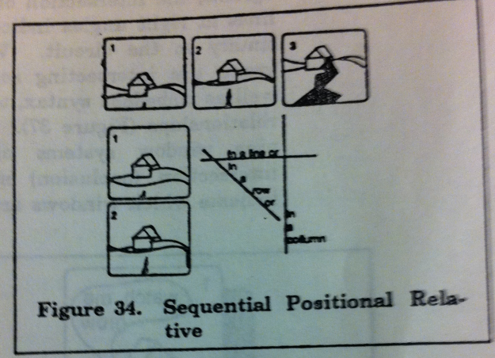
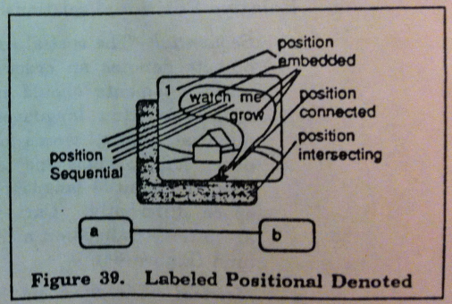
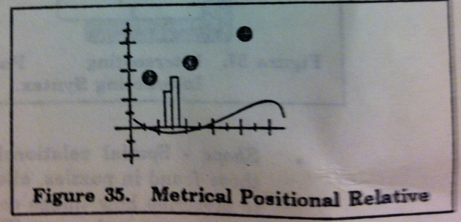
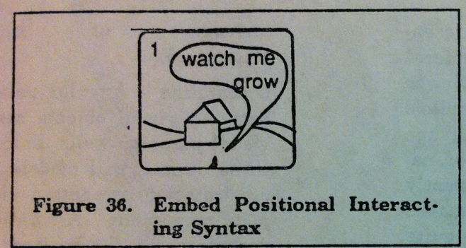
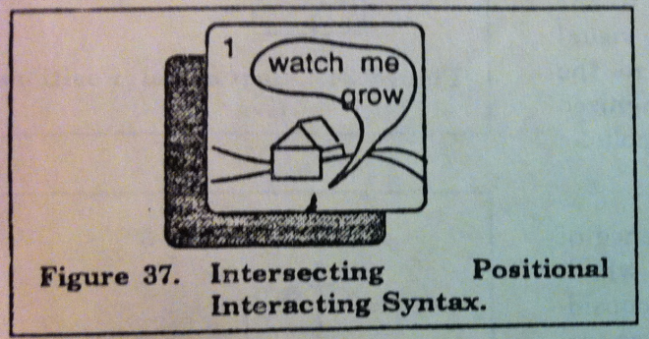
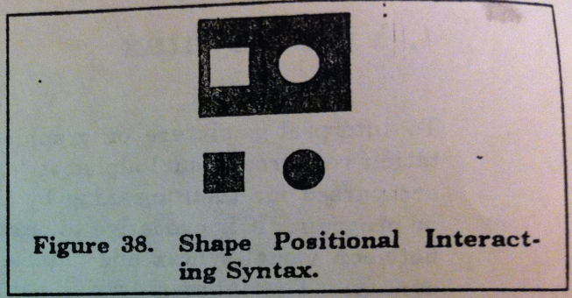
Elements of Visual Language
Graphics: Surface characteristics of VLs:
Input, representation, presentation
Presentation languages:
  Positional Relative:
    Sequential, metrical ,orientation
  Positional Interacting
    Embedded, intersecting, shape, size
  Positional Denoted
    Connected, Labeled
  Size
  Time
  Rule

Slide 5
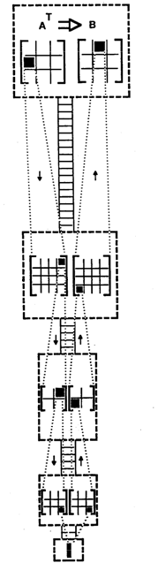
Visual language can help
Human Performance
D
isk
Memory
T
L
B
R
eg
Log S, Log N
Log T, Log S
Improving Memory allocation Performance:
  Performance tuning by fitting data to memory module 1954 Rutledge
  The Uniform Memory Hierarchy Model of Computation. Bowen Alpern, Larry Carter, Ephraim Feig, Ted Selker. Algorithmica, Vol.12: 72-109, 1994. , Visualization-90, July 1990.
    Everything on one page showed
      TLB wrong shape
      …30 times improvement for all vector operations (FFT, Mulitply…)
ALU

Slide 6
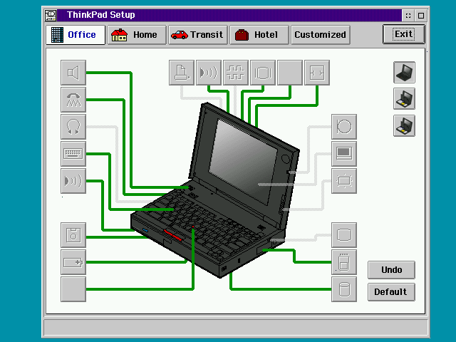
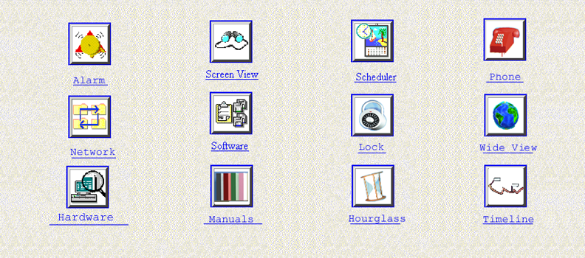
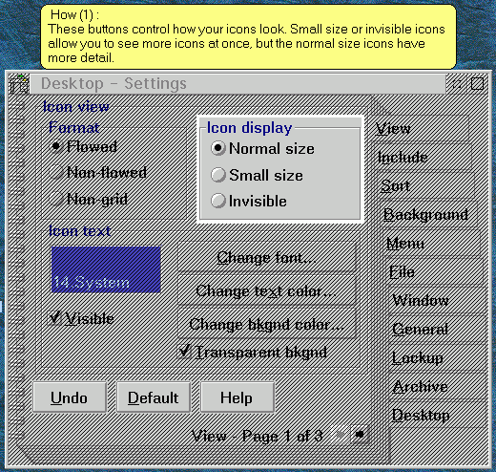
VLs can help User Interface Navigation
Sec.
20
17.5
15
12.5
10
7.5
5
Day 1
2.5
0
T1
T2
T3
T4
  Representation Matters: The Effect of 3D Objects and a Spatial Metaphor in a Graphical User Interface. Wendy Ark, D. Christopher Dryer, Ted Selker, Shumin Zhai. Proceedings of People and Computers XIII, HCI'98, H. Johnson, N. Lawrence, C. Roast (Eds.), pp. 209 –219, ACM Press, 1998
  Landmarks to Aid Navigation in a Graphical User Interface. Wendy Ark, D. Christopher Dryer, Ted Selker, Shumin Zhai. Proceedings of Workshop on Personalized and Social Navigation in Information Space, Stockholm, Sweden, March 1998.

Slide 7
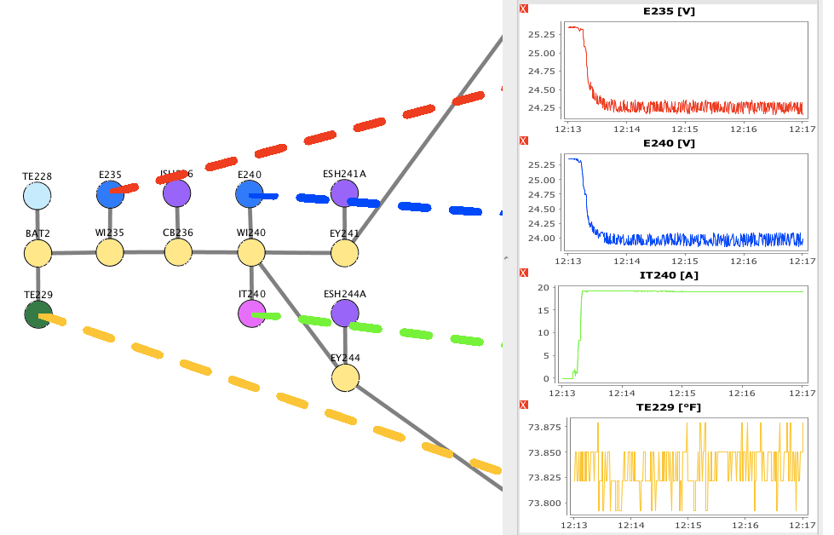
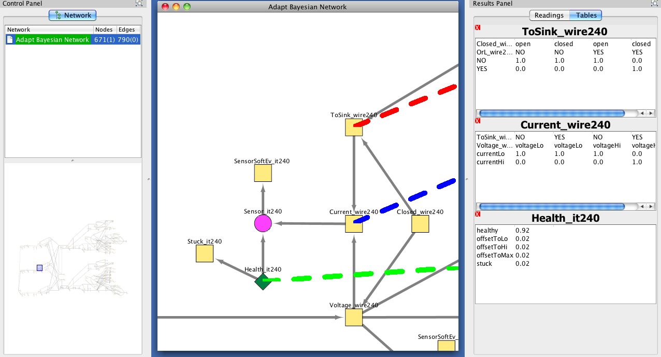
Probabilistic Reasoning and Visualization for Electrical Power Systems
Schematic view of
electrical circuit
Bayes net view of
electrical circuit
Aligned electrical data level node comparisons.
Enhances network analysis.
Aligned Bayesian metadata level node comparisons.
Enhances viewing of conditional probability tables .
ADAPT Power System
• Standardized test bed
• Easy fault injection
CHALLENGES
• Continuous dynamics, discrete events
• Timing considerations
• Transient behavior
• Sensor/system noise
Flip to demo
APPROACH
• Algorithmic construction of schematic (figure to left) and a Bayesian network of it (figure to right)
Bayesian network represents , sensor and component “health”
• Bayesian networks compiled to arithmetic circuits
RESULTS
• Winner in DX-2010 Workshop Diagnostic Competition
Compared to DX-2009 Competition, 50% reduction in sensors while preserving detection accuracy

Slide 8
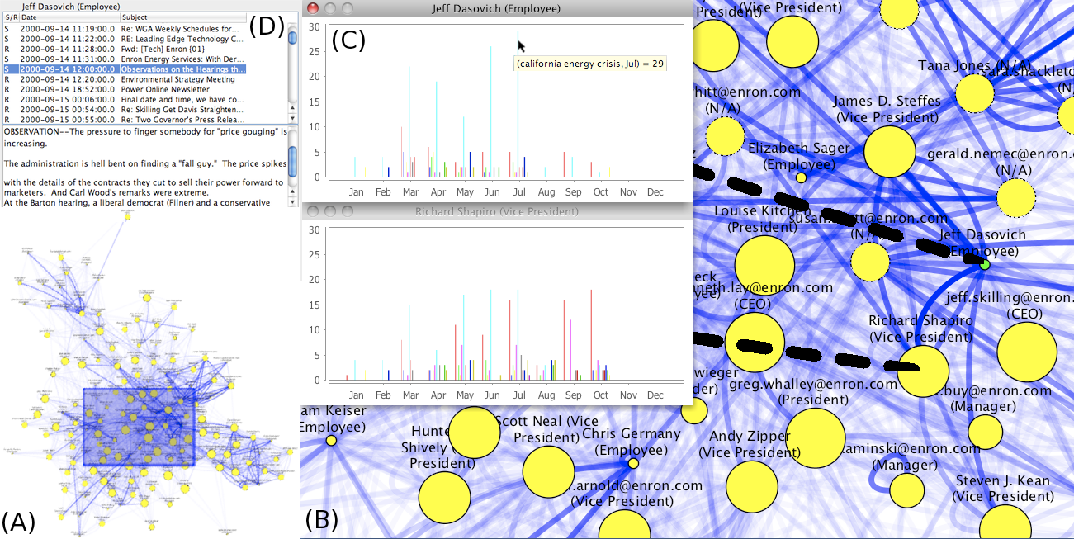
Visualization for Large-Scale Network Analysis
OBJECTIVE
Multi-step complex data comparisons
- across a data corpus
- across representational levels
DESCRIPTION
A visual analytics tool
that enriches node-edge visualization, providing comparison to other aspects of data that can not be directly encapsulated in the graph structure.
FEATURES
Visual encoding of data properties
Overview + detail
Multi-focus + context
Bubbles anchoring information to node
Multi-focus multi-level representation: (A) overview level, (B) detail level, (C) data level and (D) datum level. Anchoring the data level to the network view with large dashed bubbles allows low-level focused analysis and comparison while preserving the structure of the network.
RESULTS
Two key players (Dasovich and Williams) in Enron, who were involved in the California energy crises, were detected using our approach
- not previously been identified using visualization tools.

Slide 9
Future Work
New data sets people are talking to us about
  Smart grid, smart sensors, …
  Energy
    Photovoltaic panels
    Electrical grid Disaster management
  Re-tweeting for exposing information flow
Expose problems with & provide tools for
visualization and semi-supervised machine learning
Software
  Merge current tools, implemented in Cytoscape and Prefuse
  Disseminate tools
Visual debugging of bugs in Bayesian networks
UI evaluation to empirically show value of techniques and tool

