Slide 1
Visual Analytics Research and Education
Kwan-Liu Ma
Department of Computer Science
University of California, Davis

Slide 2
Outline
VA research at VIDi UC Davis
VA education
Mathematics foundations
Training offered by VAST contests
Recommendations
Notes:
I am going to start by talking about my visual analytics research development and then I will touch on education and training. Finally, I have a few recommendations.

Slide 3
My Vis Research
1989 – present SciVis, HPC, scalable rendering
2002 – present Infovis/VA
Computer security visualization (NSF Cybertrust)
Graph/network visualization*
Software visualization
Visualizing HPC (NSF PetaApps, HECURA)
Uncertainty visualization (NSF FODAVA)
Notes:
As some of you know, over the years, my research has been mainly in scientific visualization and high performance computing and rendering for visualization. A few years after I joined UC Davis, I started working on infovis and began with network security visualization work, which led to the annual VizSEC workshops. In early stages, my work was still largely focusing on algorithms for interactivity and visual and interface design, all very much computer science flavor. One of our interactive graph visualization algorithm is now used by FBI analysts. Then I realized that I have to look into alternative solutions such that we can better cope with scale, dimensionality, complexity, and heterogeneity. One basic approach we use is to mathematically transform data to a different space for visualization.

Slide 4
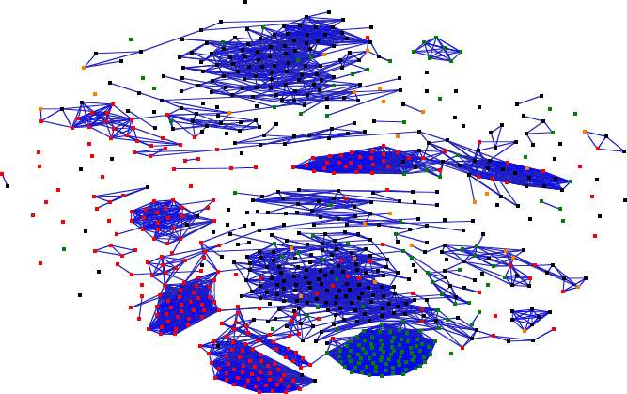
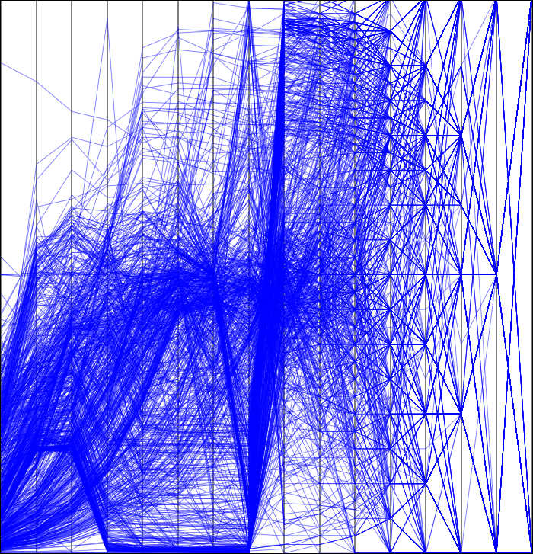
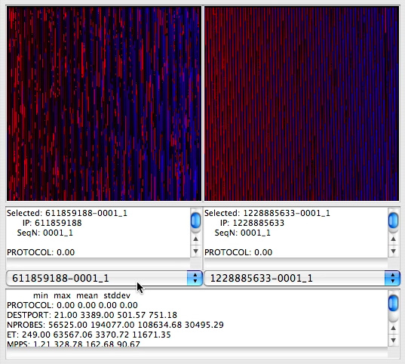
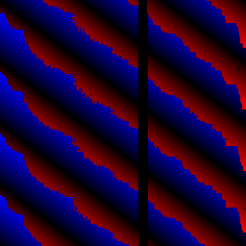
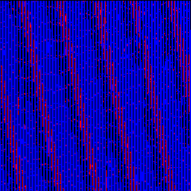
Network Security Data Analysis
Compared &
classified
Network
Stream
Filtering/
Detection
Scalograms
Overviews
Transformed
Bias
Selection
Scan
Data
Fingerprints
Detailed views
Notes:
When we worked on scan data, to cope with the continuous streams of scans, we determined we must have more automatic method to organize the scans for the analysts to examine. What we did is to transform the scan pictures into scalograms which can be systematically compared and classified. From there, we can conduct a variety of visual analysis.
ScanVis is for characterizing and classifying scans. From the scan data obtained by filtering the original network streams, a set of derived metrics are created which we call modes showing different aspects of the data. We can certainly look at the mode data directly but there are too many scans. ScanVis convert modes into much more compact scalograms which can be systematically compared and classified. The results are a graph which is composed of clusters of scans that share similar characteristics. The graph gives the user an overview of the overall data, and the user can then choose specific groups of scans to take a closer look. What the user learns from the detailed view of the scans can be used to bias the overview--forming a feedback loop of refining one’s understanding of the scans.
Let me go over some of the steps here in greater details.
What next?
Good Statistical fingerprint (average or stand div … for automatic classification and detection ..)
The end results can be used to iden/classify unknown scans …
Approximation variation of the data at that frequency
Overview: show relationships between scans
Details: individual scans for comparison

Slide 5
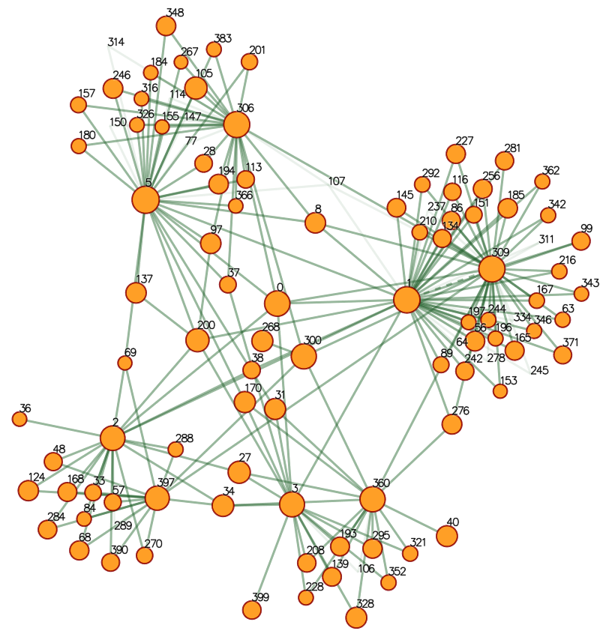
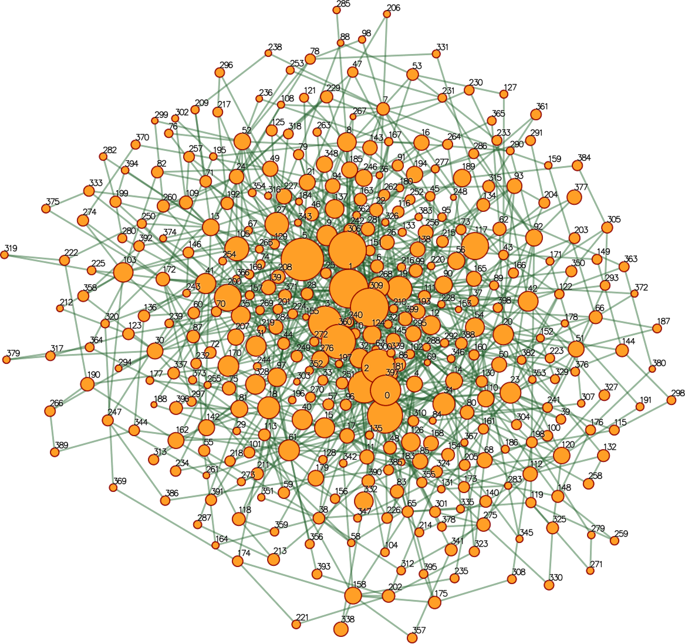
Social Network Analysis
Centrality analysis of the VAST Challenge dataset
Revealing hidden relations between 4 pairs of nodes
Notes:
Finally, on the left it’s a direct visualization of phone communication network in the VAST 2008 contest data. After centrality analysis (based on partial derivative of Markov importance with respect to the degree of nodes), as shown on the right, we are able to discover hidden relations or implicit links between 4 pairs of nodes. Increasingly, we are using mathematical methods in our solutions.
Computing the ranking of edges rather than nodes, which tells us the impact of changes in a node to the importance of another.
It becomes clear that visualizing data directly, in many cases, won’t reveal all the important information. We must seek mathematical analysis techniques to transform data or to extract structure/pattern/trend from the data, and then provide a visual interface for the analysts to browse over the resulting data.

Slide 6
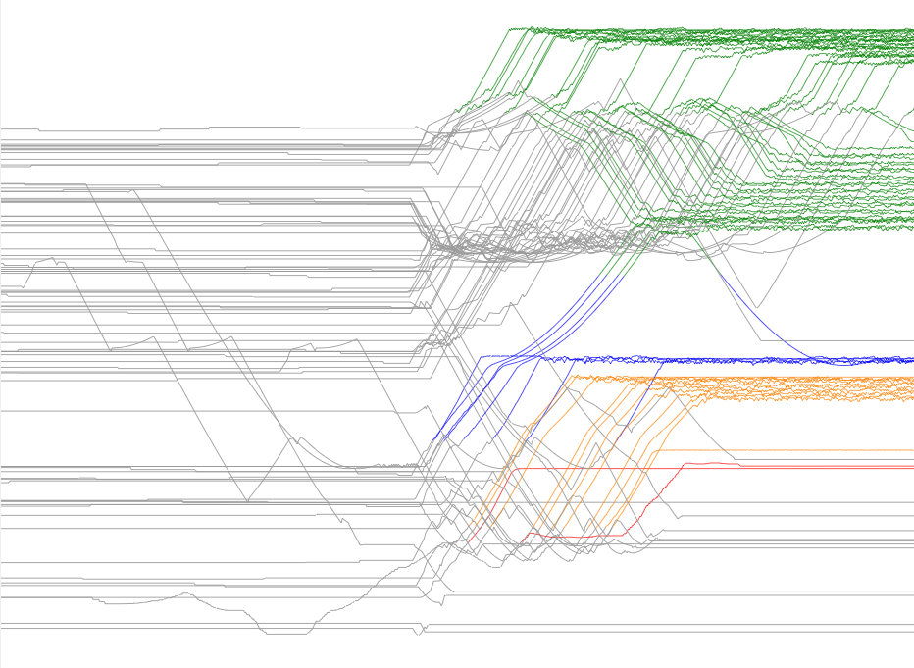
Movement/Trajectory Visualization
Notes:
Based on a proximity measure, in this case, distance from the bomb, we created this visualization. The x-axis is time, and the y-axis is distance from the bomb. Red, orange, green, and blue lines depict those who successfully left the building.The longer red line is the bomber. All remaining grey color lines show those who did not make it out. The clutter in the upper side of the plot illustrates a congestion as lines coverage (to one of the exits), and final divergence.

Slide 7
Mathematical Foundations
Our CS undergrads are required to take:
Calculus and linear algebra
Statistics and probabilities
Discrete math
What else are needed to do VA research
Advanced statistics (including dimension reduction)
Functional analysis (including transformation of functions)
Numerical analysis (understanding of numerical precision and stability)
Notes:
New graduate students often ask me what mathematics classes they should take beyond calculus, linear algebra, statistics, and discrete math. After working in visual analytics for a few years, it’s clear to me they need to know more than elementary statistics, and they should learn functional analysis as well as number analysis. The other training I find valuable is offered by the annual VAST contest.

Slide 8
Participating in VAST Contests
Very time consuming tasks
Two entries from my group in each of 2008 and 2009 contest
Data sets are high-quality, realistic, and enjoyable to work on
Workshops were well organized, and at the workshop plenty of opportunities for the Contests participants to exchange
Talks given by the professional analysts were very very useful
Our entries are later developed into research projects
We learn different tasks involved in the VA process

Slide 9
Recommendations
Collaborating with statisticians

Slide 10
Recommendations
Collaborating with statisticians
Participating in VAST contests

Slide 11
Recommendations
Collaborating with statisticians
Participating in VAST contests
Following up VAST contests

Slide 12
Recommendations
Collaborating with statisticians
Participating in VAST contests
Following up VAST contests
Assigning an analyst to each FODAVA project

Slide 13
Recommendations
Collaborating with statisticians
Participating in VAST contests
Following up VAST contests
Assigning an analyst to each FODAVA project
Creating and sharing VA curriculum

Slide 14
Recommendations
Collaborating with statisticians
Participating in the VAST contests
Following up VAST contests
Assigning an analyst to each FODAVA project
Creating and sharing VA curriculum
A VAST journal?

Slide 15
ma@cs.ucdavis.edu http://www.cs.ucdavis.edu/~ma

Slide 17
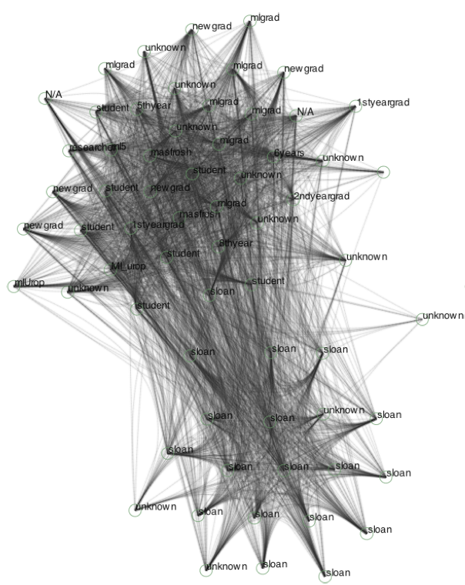
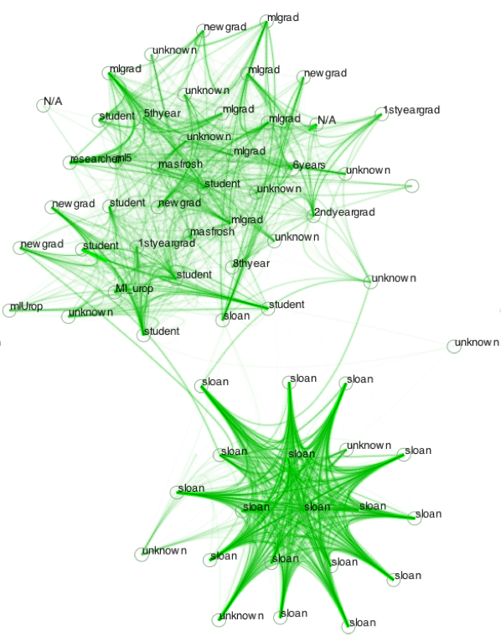
Social Network Analysis
Centrality derivatives of the MIT Reality proximity dataset
Notes:
In analyzing social network, by computing centrality derivatives, we are able to better separate the two main clusters in the MIT reality dataset, as shown on the right, the Media Lab people and the Sloan school students. We can even identify some smaller clusters within the Media labcluster.

Slide 18
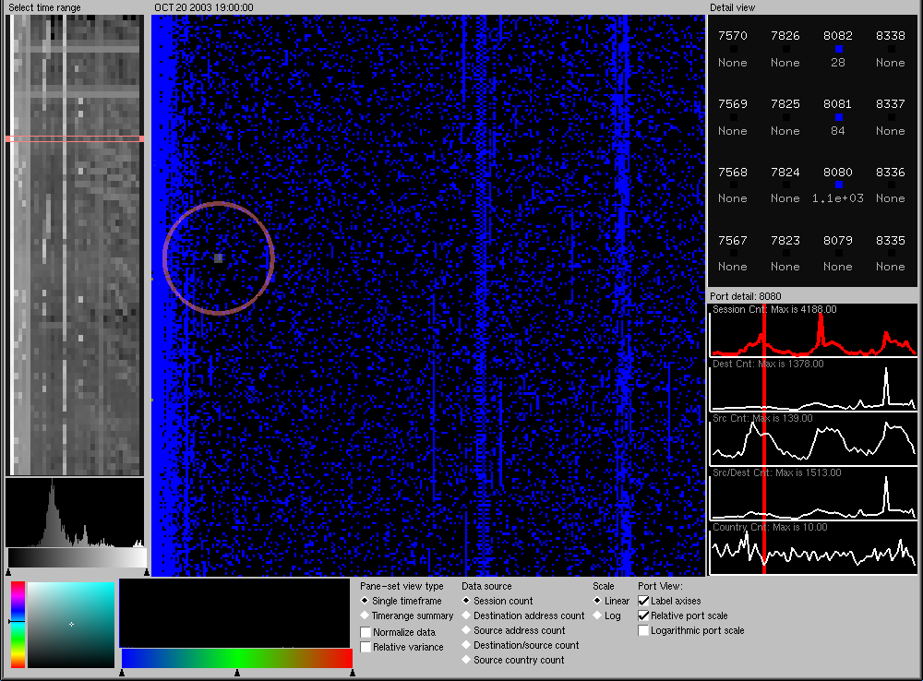
PortVis
Notes:
PortVis is a system we built for visual analysis of TCP port data. It’s a very conventional design supporting a drill down process allowing us to identify some questionable ports and see detailed information about the port. It’s more an analysis tool but not a discovery tool.
Most of the systems we have developed effectively supports the typical overview-and-drill-down-to-details process. The TCP port data visualization system provides the analyst an overview of the data collected over a period of time, as shown on the left. The user selects a particular time frame and the corresponding cumulative data is displayed in the middle. The analyst can then choose some particular port and see detailed information about that port.
Timeline vis: vertical axis=time horizontal axis=port range.
Main visualization: x axis=high byte of the port number y axis=low byte of the port number color=how many sessions on the port (dark=low white=high)

Slide 19
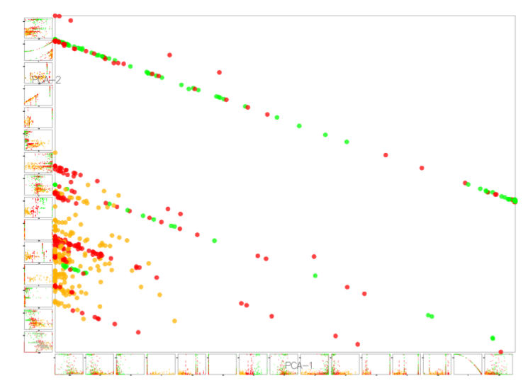
Interplay between mathematics and Visual Analytics
In the past, we did not look at the mathematical foundations of visualizations. Decisions were often ad hoc.

Slide 20
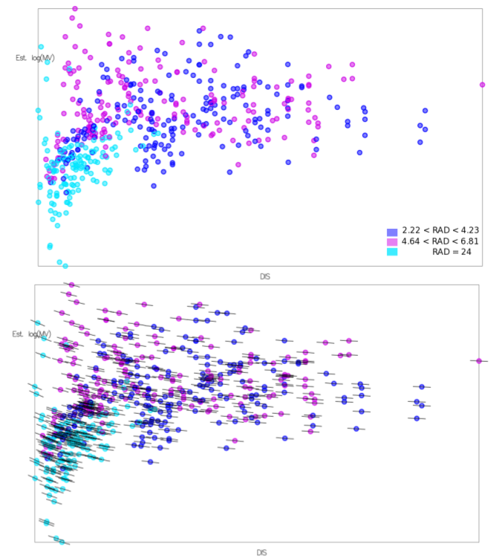
Once we begin to look at the mathematical foundations, we understand visualization as a process, where we can measure error and make inferences of data as a sampling of continuous data. Derivatives of such data provides important cues for understanding data.

Slide 21
One of the challenges is how to extract continuous representations of otherwise discrete data, e.g., a social network. The exploration of the mathematical foundations led to the development of centrality derivatives. The social network is now seen as a discretization of a continuous distribution of centrality, subject to differentiation, integration, etc.

Slide 22
Notes:
Derivatives provide a number of applications for visualizing social networks. In this case, it provides a ranking of edges that highlights the main clusters and groups.

Slide 23
Lessons Learned
In general, the study of the mathematical foundations of visual analytics leads to a general framework for understanding discrete data. In our case, the process of visual analytics is a transformation that propagates error depending on how sensitive the transformation is. The general strategy of computing the sensitivity coefficients of a transformation may have profound implications for the study and evaluation of visual analytic tools.

